Slide 1
Classes-I
Said Nabi

Slide 2
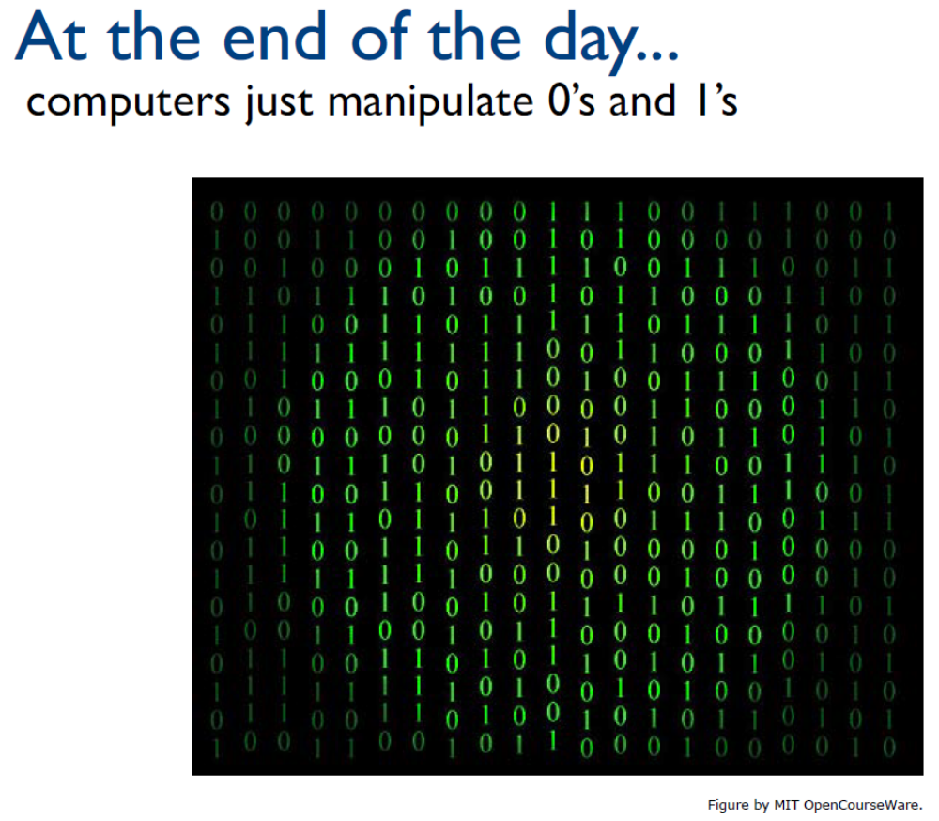
But binary is hard (for humans) to work with…

Slide 3
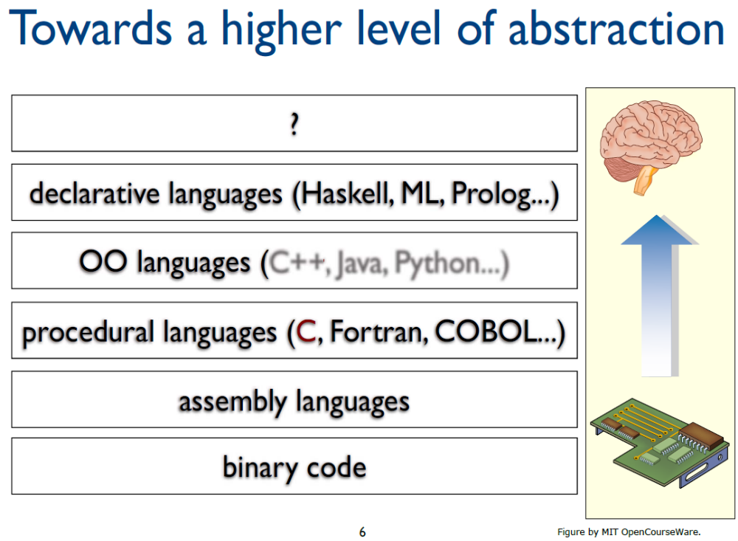
Notes:
Programming languages ka evolution machine ko smart banane ka safar nahi…
Human ko comfortable banane ka safar hai.”

Slide 4
Procedural Programming
Data is stored in a collection of variables and/or structures, along with a set of functions that perform operations on the data
The data and the functions are separate entities
  double width;
  double length;
  displayWidth();
  displayLength();
  displayArea();
Data
Functions

Slide 5
Limitations of Procedural Programming
Variables and data structures are passed to the functions that perform the desired operations
What if the data types or data structures change? Many functions must also be changed – Error prone
As the procedural programs become larger, function hierarchies become more complex:
  difficult to understand and maintain
  difficult to modify and extend
Notes:
├── processStudent()
│ ├── validateStudent()
│ ├── calculateGrade()
│ └── updateDatabase()

Slide 6
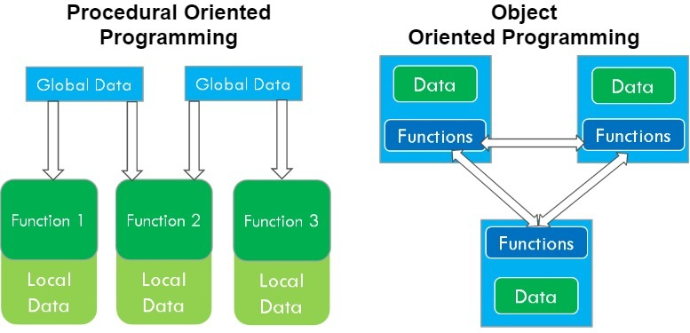
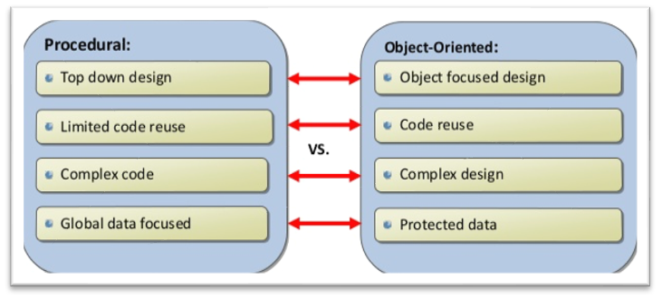
Procedural VS. Object-Oriented Programming
Procedural programming focuses on creating procedures, object-oriented programming focuses on creating objects
Notes:
insertCard()
enterPin()
checkBalance()
withdrawCash()
printReceipt()
Yahan focus kis pe hai?
👉 Steps
👉 Functions
👉 Process
Data secondary hai.

Slide 7
Object-oriented Programming (OOP)
Object-oriented programming approach organizes programs in a way that mirrors the real world, in which all objects are associated with both attributes and behaviors
Object-oriented programming involves thinking in terms of objects
An OOP program can be viewed as a collection of cooperating objects

Slide 8
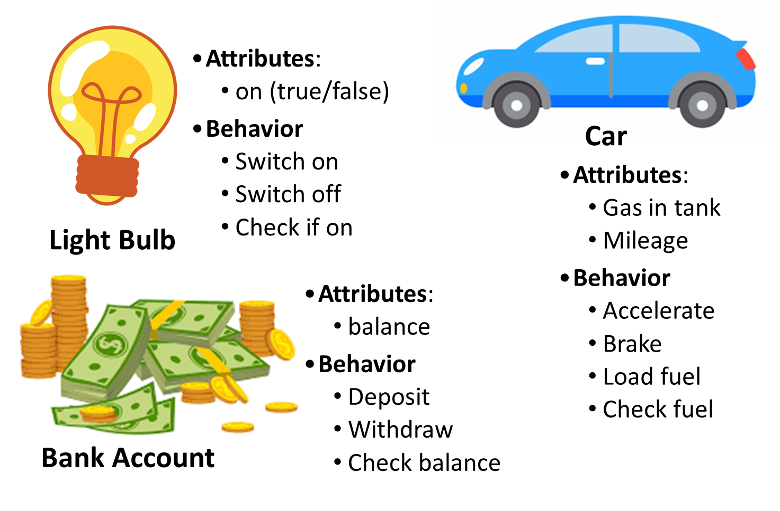
Some Examples of Objects

Slide 9
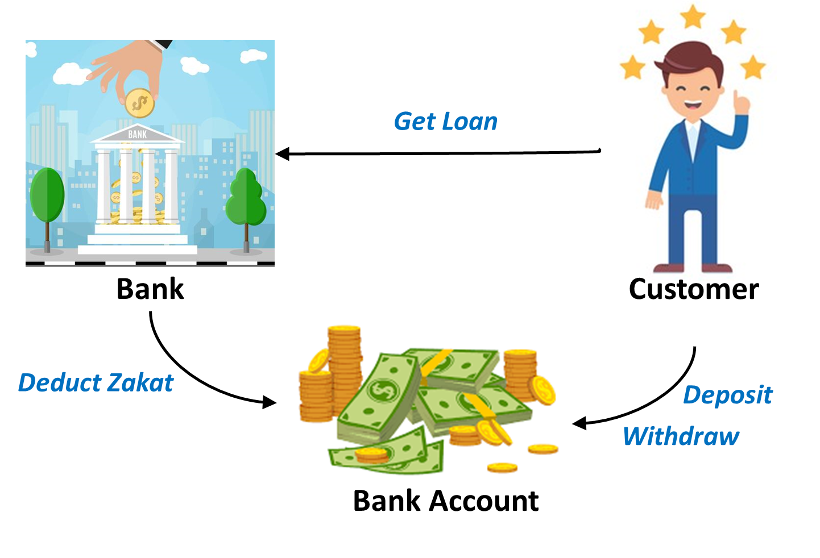
Objects Interact with Each Other

Slide 10
Object-Oriented Programming Terminology
Class: an abstract data-type or a user-defined data type, similar to a struct (allows bundling of related variables)
Object: an instance of a class, in the same way that a variable can be an instance of a struct
Object Oriented Programming-Spring 23

Slide 11
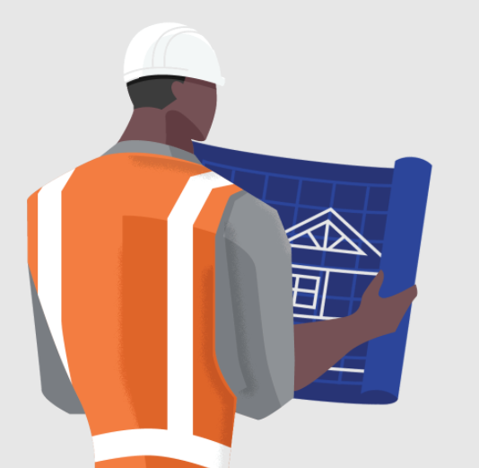

Classes and Objects
A class is like a blueprint and objects are like houses built from the blueprint
An object is an instance (realization) of a class
A single class can have multiple instances

Slide 12
Classes in OOP
Classes are constructs/templates that define objects of the same type.
A class uses Variables (data fields) to define state
A class uses Functions to define behaviors.
Additionally, a class provides a special type of function, known as constructors:
  Invoked to construct objects from the class.

Slide 13
Objects in OOP
An object has a unique identity, state, and behaviors.
The state of an object consists of a set of data fields (also known as properties) with their current values.
The behavior of an object is defined by a set of functions.

Slide 14
Class is a Type
You can use primitive data types to define variables.
You can also use class names to declare object names.

Slide 15
Introduction to Classes
Objects are created from a class
Format:
  class ClassName
  {
  variable declaration;
  methods declaration;
  };

Slide 16
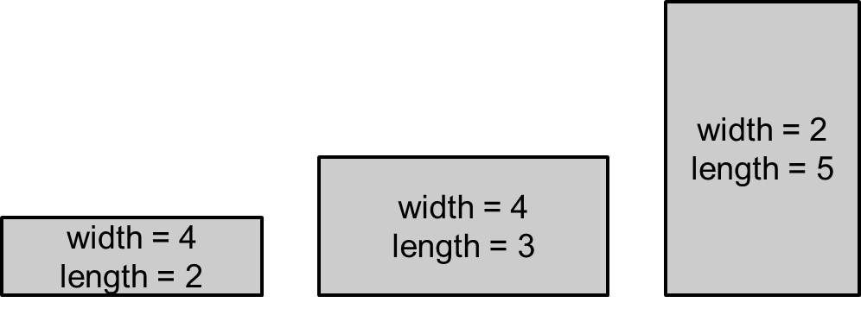
Class Example
  class Rectangle
  {
  double width;
  double length;
  displayWidth();
  displayLength();
  displayArea();
  };
Attribute values define the state in objects
Functions define the behavior of objects
Data (attributes)
Functions

Slide 17
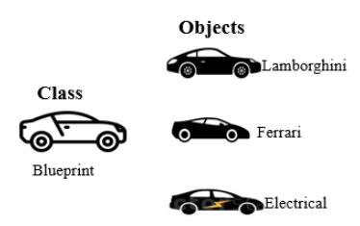
Defining an Instance of a Class
An object is an instance of a class, to create an object:
  ClassName objectName;
  Rectangle r;
Every object has a unique identity, its own state

Slide 18
Access Specifiers
Used to control access to members (attributes and methods) of the class
public: can be called / accessed by functions outside of the class
private: can only be called / accessed by functions that are members of the class

Slide 19
Class Example
Rule of Thumb:
Keep data attributes private and functions public
To protect data from unwanted access and modification a.k.a data hiding
  class Rectangle
  {
  private:
  double width;
  double length;
  public:
  void displayWidth();
  void displayLength();
  void displayArea();
  };
Private
Members
Public Members

Slide 20
More on Access Specifiers
Can be listed in any order in a class
Can appear multiple times in a class
If not specified, the default is private

Slide 21
Access Specifiers
A class is similar to struct, but not the same
Members of a struct are public by default
  struct Rectangle
  {
  double width;
  double length;
} r1;
cout << r1.width; //legal because width is public
Members of a class are
private by default

Slide 22
Access Specifiers
A class is similar to struct, but not the same
Members of a class are private by default
  class Rectangle
  {
  double width;
  double length;
};
Rectangle r1; //class object
cout << r1.width; //ERROR, width is private

Slide 23
Access Specifiers
class Rectangle {
  private:
  double width;
  double length;
  public:
  double getWidth(){
  return width; }
};
Rectangle r1; //class object r1
cout << r1.getWidth(); //works getWidth() is public
Access any public members
of the class using the dot operator:
  r1.displayArea()

Slide 24
Defining a Member Functions
Can be defined within the class declaration (in-line member function) or outside the class (out-of-line member functions)
class Rectangle {
  private:
  double width;
  double length;
  public:
  double calcArea() {
  return width * length; //inline func }
  };
Notes:
“Small/simple function → inline
Large/complex function → out-of-line

Slide 25
Defining a Member Functions
When defining a member function outside a class (out-of-line function):
  Put prototype in class declaration
  Define function outside using class name and scope resolution operator (::)
  Combine class name with member function name
returnType ClassName::MemberFunctionName( ){
    …………
  }
Different classes can have member functions with the same name

Slide 26
Defining a Member Functions
class Rectangle {
  private:
  double width;
  double length;
  public:
  double calcArea(); //prototype
}; //class declaration ends
double Rectangle::calcArea(){
return width * length; //out-of-line func
}

Slide 27
Defining a Member Functions
Whether member function is inline or out-of-line
Access remains the same as declared in the class
class Rectangle {
  private:
  double width;
  double length;
  public:
  double calcArea(); //prototype
}; //class declaration ends
double Rectangle::calcArea()
    { return width * length; }

Slide 28
Private Member Functions
Private Member Functions:
  Only accessible (callable) from member functions of the class
  No direct access possible (with object instance of the class)
  Can be: inline / out-of-line

Slide 29
Private Member Functions
class Rectangle {
  private:
  double width;
  double length;
  double calcArea();
  public:
  void displayArea(){ cout<< calcArea();}
};
double Rectangle::calcArea(){
return length * width;
}
private member function
(out-of-line)

Slide 30
Using Private Member Functions
A private member function can only be called by another member function
It is used for internal processing by the class, not for use outside of the class

Slide 31
Private Member Functions
class Rectangle {
  private:
  double width;
  double length;
  double calcArea(){
  return length * width;
  }
  public:
  void displayArea(){ cout<< calcArea();}
};
private member function
(inline)

Slide 32
Setters and Getters
Setter (Mutator): a member function that assigns a value to a class data member
Getter (Accessor): a function that reads/gets a value from a class data member.

Slide 33
class Rectangle {
  private:
  double width;
  double length;
  public:
  void setWidth(double w){ //setter
  width = w; }
  void setLength(double l){ //setter
  length = l; }
  double getWidth(){ //getter
  return width; }
  double getLength(){ //getter
  return length; }
  }

Slide 34

Code outside the class must use the class's public member functions to interact with the object
Constraints can be added in setters to prevent unwanted values in data members

Slide 35
Using const With Member Functions
A const member function is read-only, cannot change the value of any attribute
class Rectangle
  {
  private:
  double width;
  public:
  void changeWidth() const {
  width++; //ERROR }
  };

Slide 36
Getters do not change an object's data, so they should be marked const.
class Rectangle
{
private:
double width;
double length;
public:
void setWidth(double);
void setLength(double);
double getWidth() const
{ return width; }
double getLength() const
{ return length; }
double getArea() const
{ return width * length; }
};

Slide 37
Avoiding Stale Data
Some data is the result of a calculation.
In the Rectangle class the area of a rectangle is calculated.
  length x width
If we were to use an area variable here in the Rectangle class, its value would be dependent on the length and the width.
If we change length or width without updating area, then area would become stale.
To avoid stale data, it is best to calculate the value of that data within a member function rather than store it in a variable.

Slide 38
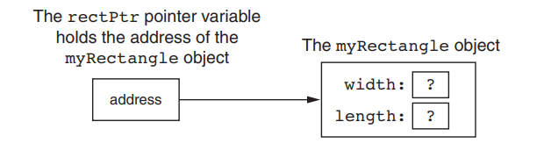
Pointer to an Object
Rectangle myRectangle; //Rectangle object
Can define a pointer to an object:
Rectangle *rPtr; //Rectangle pointer
Can access public members via pointer:
  rPtr = &myRectangle;

Slide 39
Pointer to an Object
Can access public members via pointer:
  rPtr = &myRectangle;
Recall you can use * and . OR ->
  rPtr->setWidth(12.5);
  cout << rPtr->getLength() << endl;

Slide 40
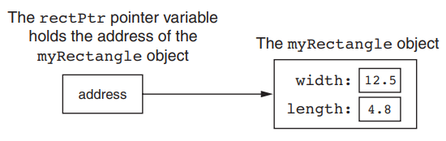
Pointer to an Object
Can access public members via pointer:
  rPtr = &myRectangle;
  rPtr->setWidth(12.5);
  rectPtr->setLength(4.8);

Slide 41
Pointer to an Object
Dynamically allocate objects using a pointer
Rectangle *rPtr = new Rectangle;
rPtr->setLength(12.5);
rPtr->setWidth(10.3);
Deallocate memory and delete object
delete rPtr;
rPtr = NULL;

Slide 42
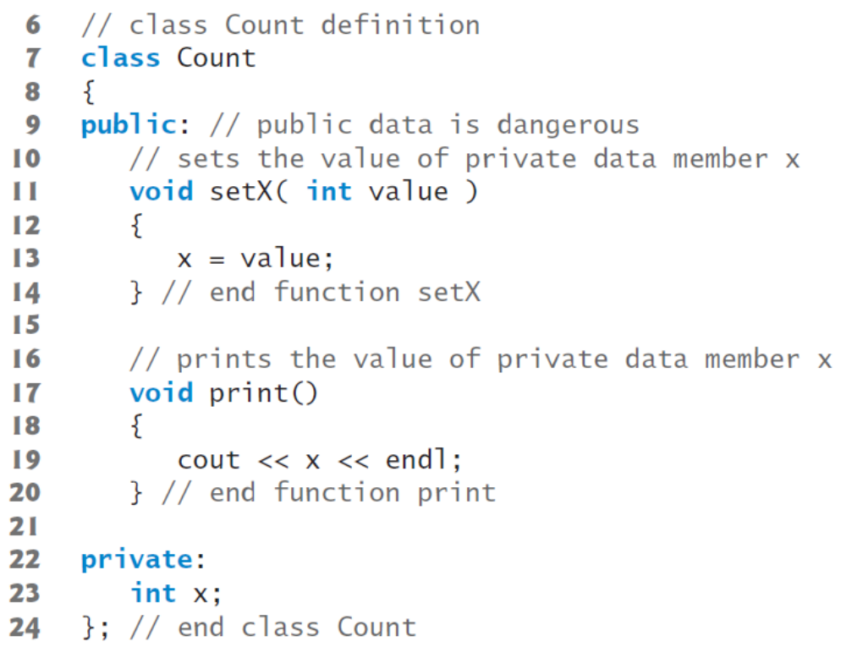
Reference to Objects

Slide 43
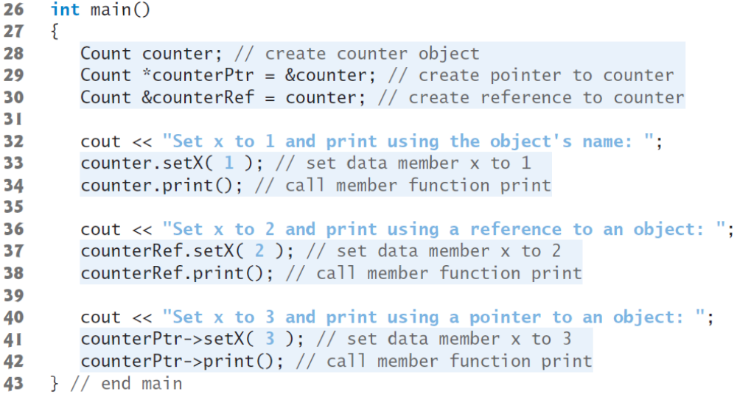
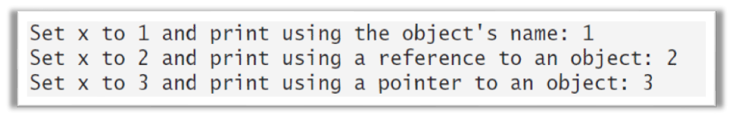
Reference is an alias to an existing object

Slide 44
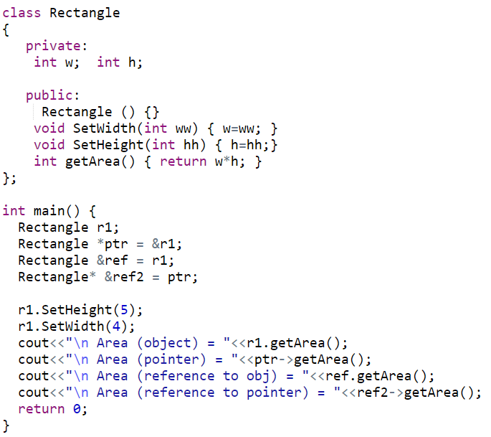
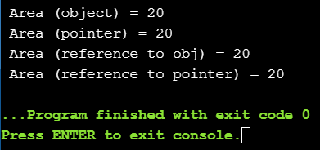
Reference and Pointers to Objects

